Slide 1
Receipt and Invoice Digitizer
Automated OCR, Extraction, and Analytics System
BY Gajendra Rajpoot

Slide 2
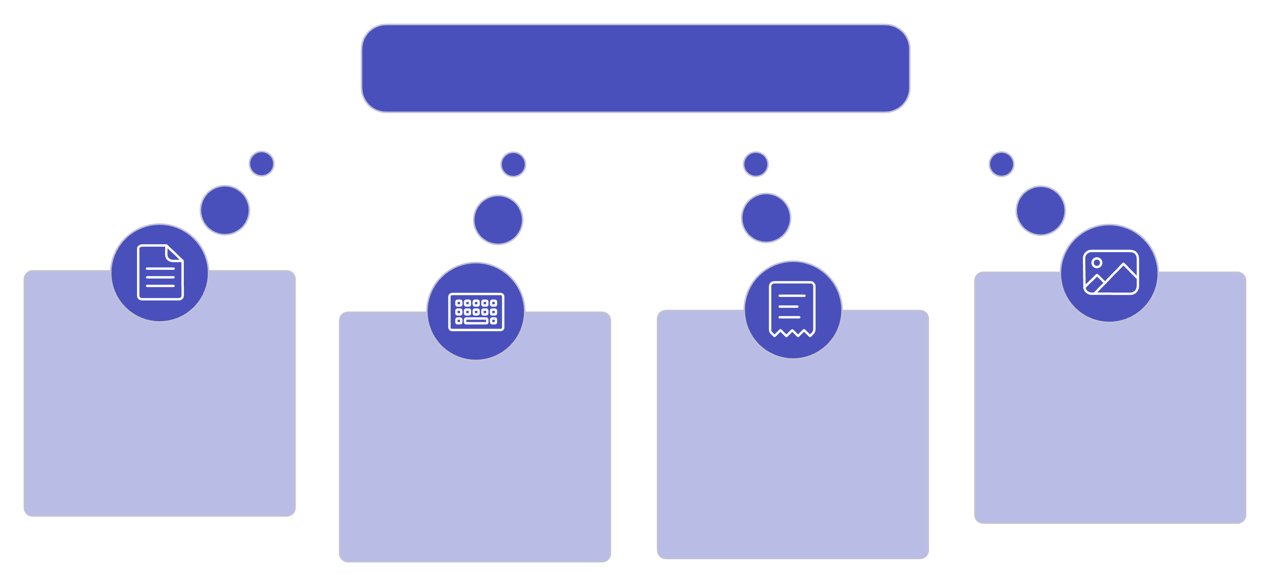

Introduction
Recordkeeping Challenges
Paper Records
Unstructured Data
Manual Entry
Data Decay

Slide 3
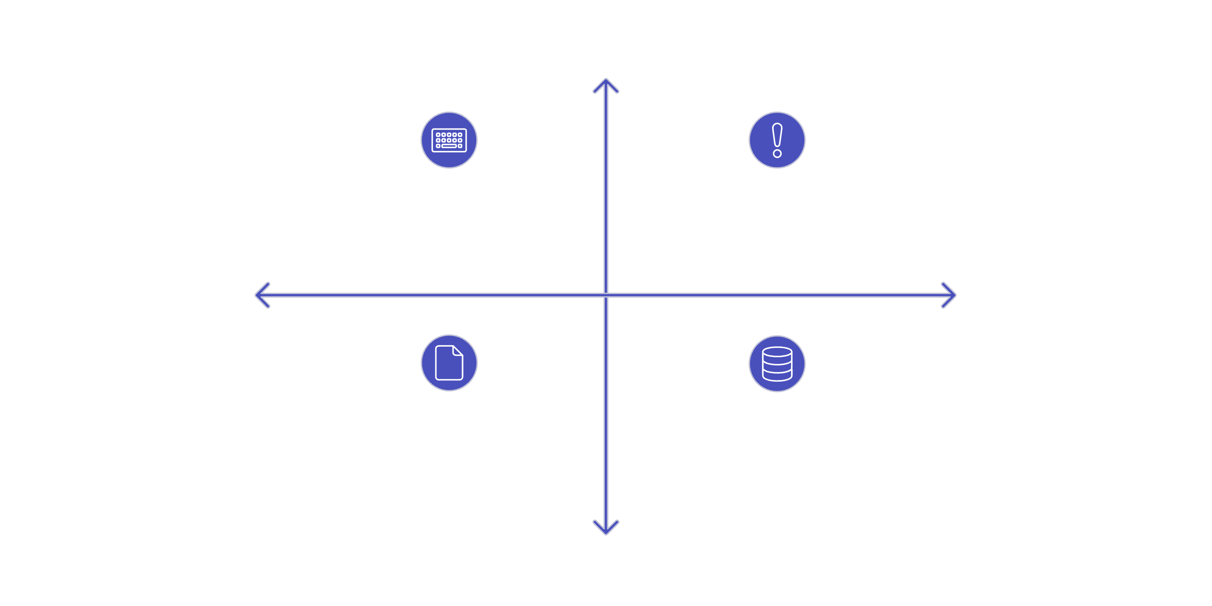
Problem Statement
High Severity
Inefficient Data Entry
High Error Rate
Low Frequency
High Frequency
Unstructured Data
Data Loss & Organization
Low Severity

Slide 4
Project Objective
01
02
Automate Document Ingestion
Intelligent Field Extraction
To replace manual data entry by automatically scanning and converting receipt/invoice images into digital text using OCR technology.
To precisely parse and categorize unstructured data into specific fields (Vendor, Date, Invoice ID, Tax, and Total Amount) using NLP and Regex.
03
04
Data Validation & Integrity
Structured Data Storage
To ensure accuracy by implementing automatic checks (e.g., verifying that Subtotal + Tax = Total) and detecting duplicate uploads.
To move away from file folders by storing processed information in a queryable SQL database for long-term retention and management.
05
06
Efficient Search & Retrieval
Visualization & Reporting
To create a system where users can instantly locate specific financial records by searching for Vendor Name, Date, or Amount.
To provide a user-friendly Web Dashboard for uploading files, viewing spending analytics, and exporting reports to CSV/Excel.

Slide 5
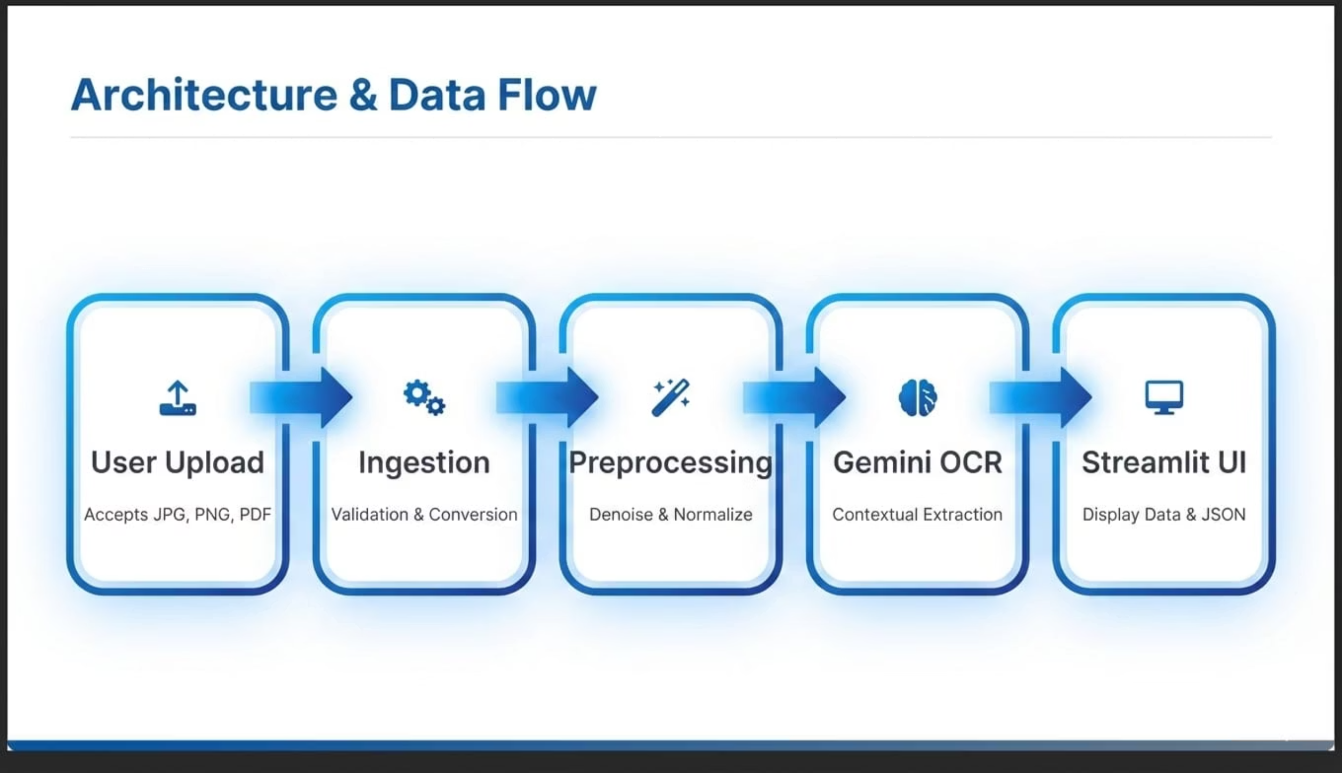
Architecture And Data Flow

Slide 6
Core Modules
Document Ingestion
OCR & Text Extraction
Uploads via PDF/Image.
Tesseract OCR engine to extract raw text.
Preprocessing (Denoise, Grayscale, Binarization).
Field Extraction
Database & Reporting
NLP/Regex to identify Vendor, Date, Tax, and Totals.
SQLite storage and Streamlit Dashboard.

Slide 7
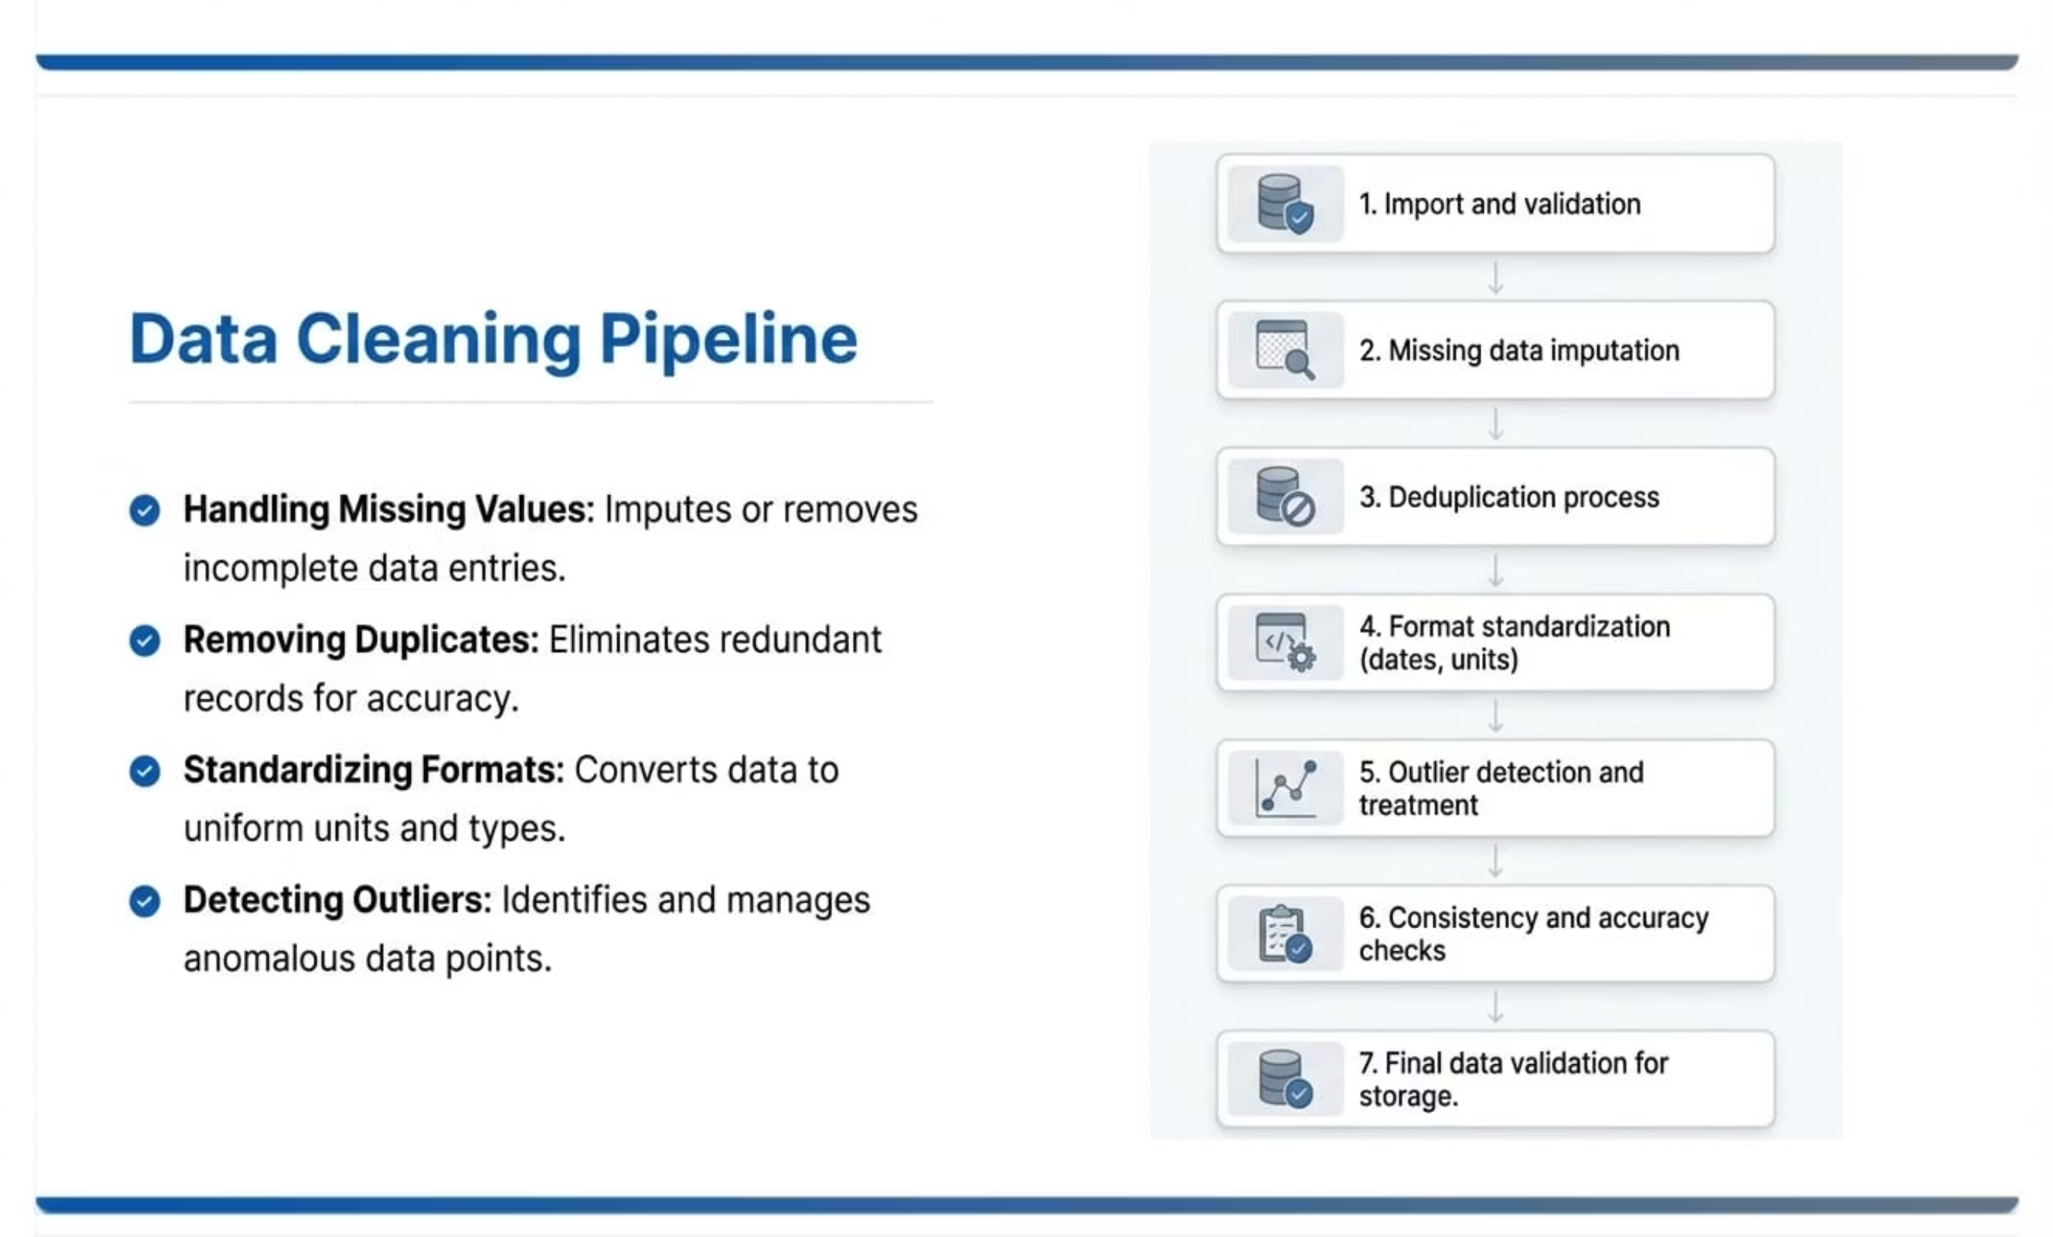
Image Preprocessing

Slide 8
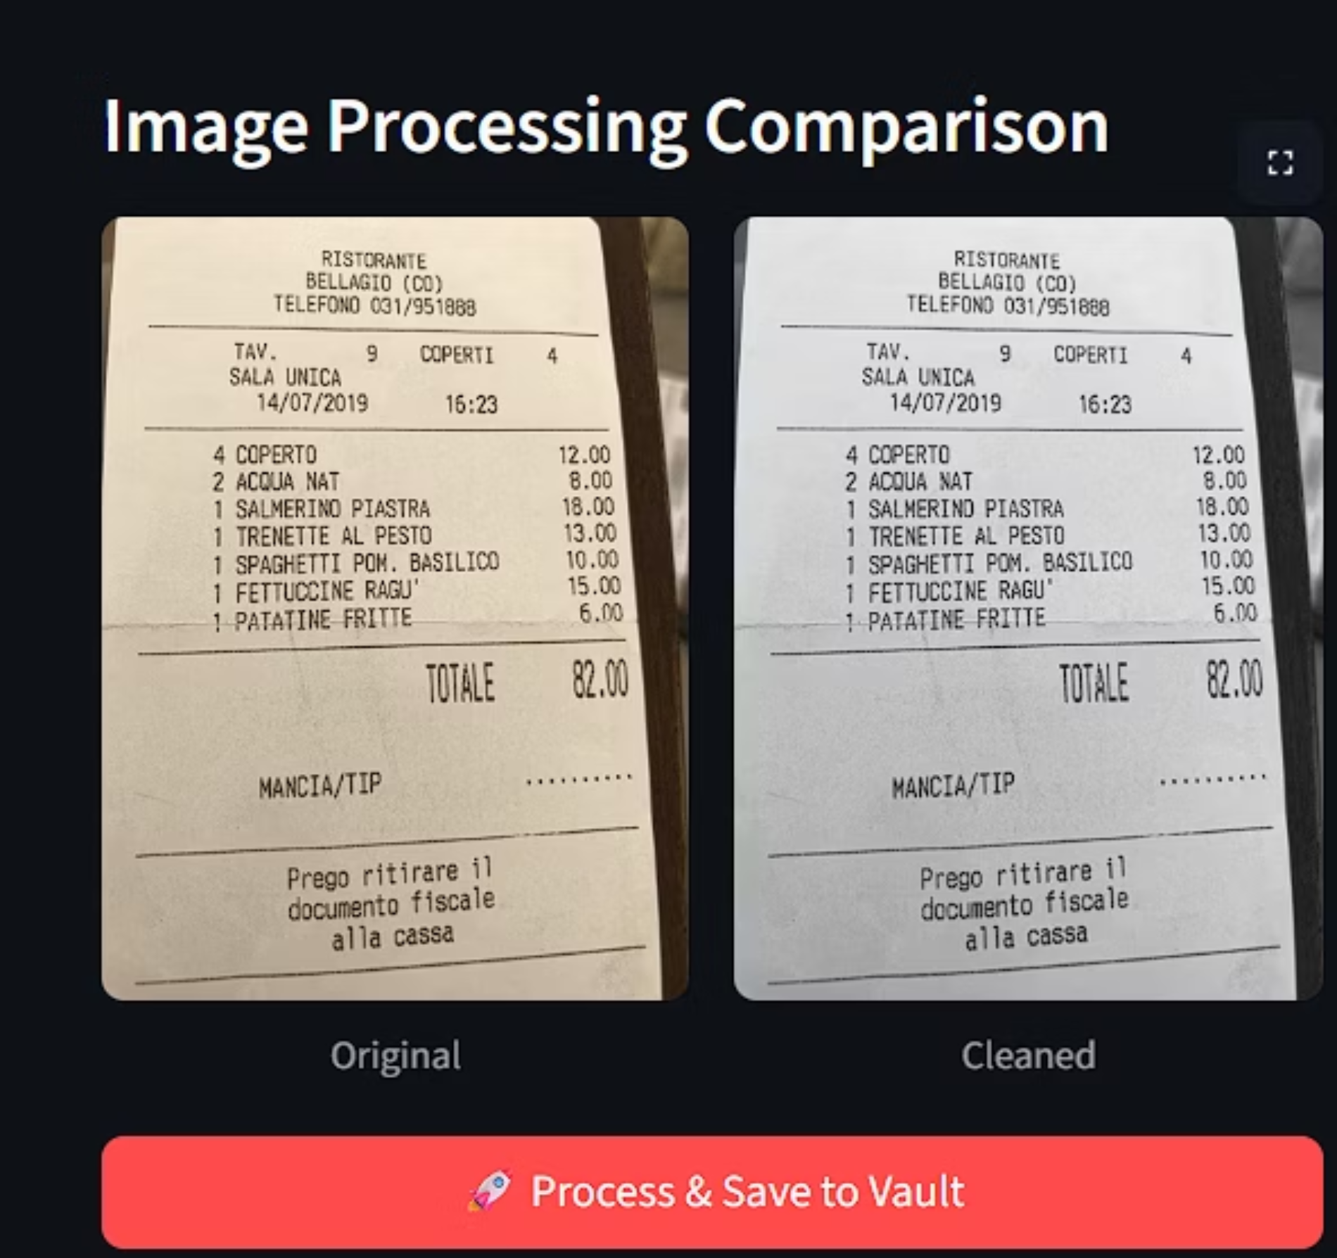
OCR Preprocessing

Slide 9
Project Outcomes (Milestone 1)
1
Automated OCR-based text extraction
2
Field-level parsing
3
Searchable Database
4
Interactive Web Dashboard
5
Error Handling & Validation

Slide 10
Technology Stack
1
2
Languages
Frontend
Python 3.9+
Streamlit
3
4
OCR
Data Processing
Tesseract (Google)
Pandas, NumPy, Regular Expressions (Re)
5
6
Visualization
Database
Plotly Express
SQLite3

Slide 11
User Interface
Smart Capture & Validation
Automated Digital Ledger
Visual Financial Insights
Features a drag-and-drop upload interface with real-time "side-by-side" image comparison, allowing users to instantly verify that the OCR system has correctly read their receipt.
Automatically extracts key data (Merchant, Date, ID) and catalogs it into a persistent, searchable table, eliminating the need for manual data entry.
Transforms raw expense data into actionable intelligence using interactive Donut Charts (spending distribution) and Bar Graphs (total spend by merchant).

Slide 12
Spending Insights Dashboard
Pie Chart
Bar Graph
Timeline
Spending distribution by Merchant.
Total expenses per category.
Tracking expenditure trends over dates.
Impact: Instant visibility into financial habits.

Slide 13
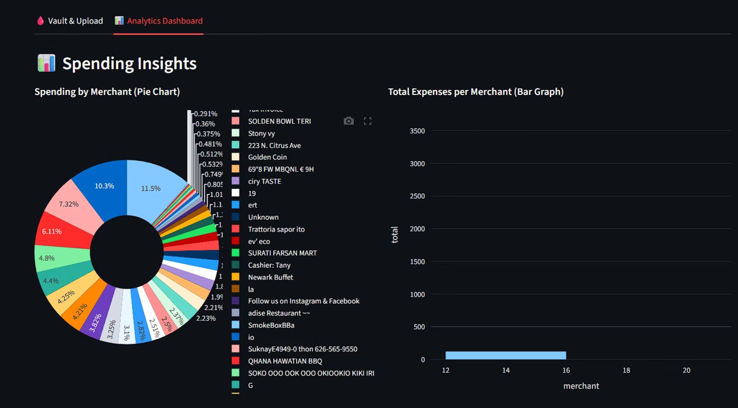

Slide 14
THANK YOU

